Slide 1
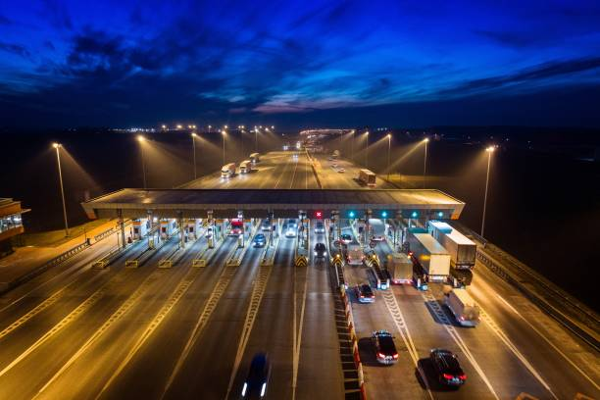

CSA4388 – Internet Programming for Gaming
ONLINE
TOLLGATE
APPLICATION
Abstract
"Online Tollgate Application" is a user-centric web application designed for efficient management. Developed using Visual Studio for frontend development and powered by XAMPP with PHP for backend operations, the platform offers users a streamlined experience to make tollgate payments easily. Users can go through the website before reaching the tollgate and can make payments through online. The application supports comprehensive details of the passenger passing through the tollgate and it also provides a search space to find the passengers based on date, vehicle, toll amount.

Slide 2
ONLINE
TOLLGATE
APPLICATION
Abstract
"Online Tollgate Application" is a user-centric web application designed for efficient management. Developed using Visual Studio for frontend development and powered by XAMPP with PHP for backend operations, the platform offers users a streamlined experience to make tollgate payments easily. Users can go through the website before reaching the tollgate and can make payments through online. The application supports comprehensive details of the passenger passing through the tollgate and it also provides a search space to find the passengers based on date, vehicle, toll amount.

Slide 3
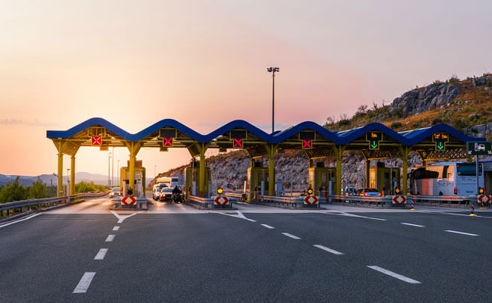

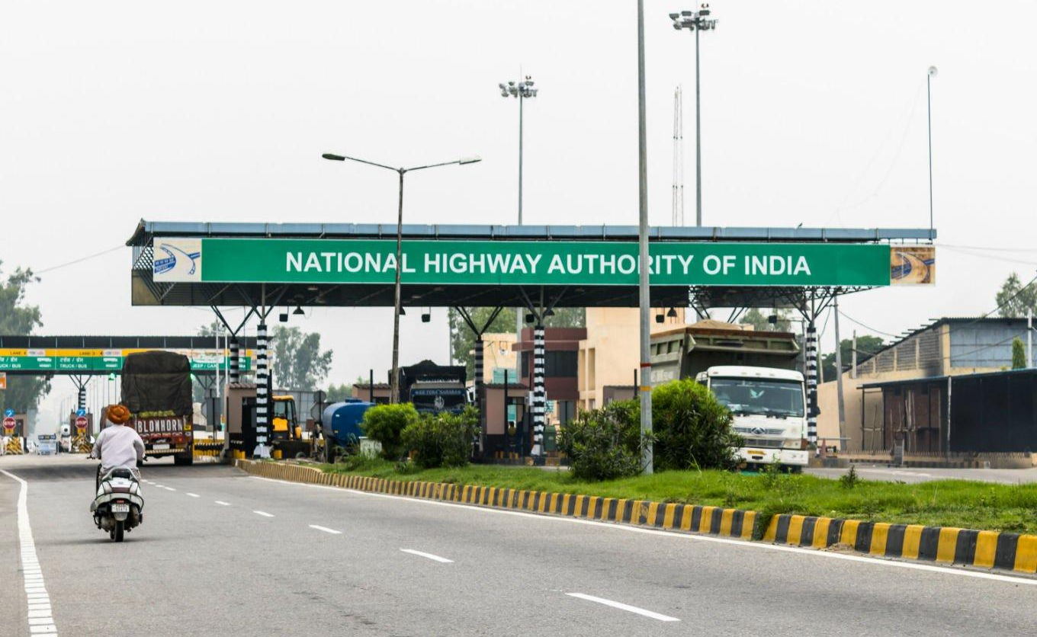
Project Description
Introduction
The Online Toll Gate Application is designed to simplify and streamline the toll payment process, providing users with a convenient and efficient way to manage toll transactions online. The application offers a user-friendly interface where vehicle owners can register their vehicles, make toll payments, and search for transaction records based on various criteria such as vehicle type, toll amount, and date. The primary objectives of this application are to enhance convenience, improve efficiency, ensure accessibility, maintain comprehensive transaction records, and provide a smooth user experience.
The Online Toll Gate Application streamlines toll payments by offering a user-friendly web interface for vehicle registration, payment processing, and transaction record searching. The application includes:
Proposed Method
Frontend Development: Utilizing Visual Studio for designing responsive and intuitive user interfaces.
Backend Development: Using XAMPP stack (Apache, MySQL, PHP) to handle server-side scripting, database management via phpMyAdmin, and ensuring secure data storage and retrieval.

Slide 4
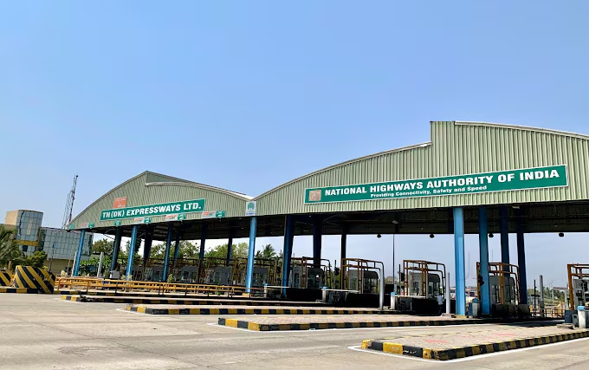
Project Description
Problem Description
Introduction
Existing System
The existing manual toll payment systems are fraught with inefficiencies that impede smooth travel experiences for commuters. Long wait times at toll booths are a common problem, as the manual process of collecting tolls slows down traffic flow and leads to extended queues. This not only causes delays but also results in increased fuel consumption and higher emissions due to idling vehicles, contributing to environmental pollution.
Proposed System
. The system features user registration and authentication, ensuring secure access and data protection. It includes a responsive design for compatibility across devices and utilizes a robust architecture with a MySQL database, PHP for server-side processing, and HTML, CSS, and JavaScript for a user-friendly interface. This centralized platform will streamline toll collection, reduce time spent at toll gates, and offer a secure, modern solution for toll management.
The Online Toll Gate Application is designed to simplify and streamline the toll payment process, providing users with a convenient and efficient way to manage toll transactions online. The application offers a user-friendly interface where vehicle owners can register their vehicles, make toll payments, and search for transaction records based on various criteria such as vehicle type, toll amount, and date. The primary objectives of this application are to enhance convenience, improve efficiency, ensure accessibility, maintain comprehensive transaction records, and provide a smooth user experience.
The Online Toll Gate Application streamlines toll payments by offering a user-friendly web interface for vehicle registration, payment processing, and transaction record searching. The application includes:
Proposed Method
Frontend Development: Utilizing Visual Studio for designing responsive and intuitive user interfaces.
Backend Development: Using XAMPP stack (Apache, MySQL, PHP) to handle server-side scripting, database management via phpMyAdmin, and ensuring secure data storage and retrieval.

Slide 5
Project Description
Problem Description
Introduction
Existing System
The existing manual toll payment systems are fraught with inefficiencies that impede smooth travel experiences for commuters. Long wait times at toll booths are a common problem, as the manual process of collecting tolls slows down traffic flow and leads to extended queues. This not only causes delays but also results in increased fuel consumption and higher emissions due to idling vehicles, contributing to environmental pollution.
Proposed System
. The system features user registration and authentication, ensuring secure access and data protection. It includes a responsive design for compatibility across devices and utilizes a robust architecture with a MySQL database, PHP for server-side processing, and HTML, CSS, and JavaScript for a user-friendly interface. This centralized platform will streamline toll collection, reduce time spent at toll gates, and offer a secure, modern solution for toll management.
The Online Toll Gate Application is designed to simplify and streamline the toll payment process, providing users with a convenient and efficient way to manage toll transactions online. The application offers a user-friendly interface where vehicle owners can register their vehicles, make toll payments, and search for transaction records based on various criteria such as vehicle type, toll amount, and date. The primary objectives of this application are to enhance convenience, improve efficiency, ensure accessibility, maintain comprehensive transaction records, and provide a smooth user experience.
The Online Toll Gate Application streamlines toll payments by offering a user-friendly web interface for vehicle registration, payment processing, and transaction record searching. The application includes:
Proposed Method
Frontend Development: Utilizing Visual Studio for designing responsive and intuitive user interfaces.
Backend Development: Using XAMPP stack (Apache, MySQL, PHP) to handle server-side scripting, database management via phpMyAdmin, and ensuring secure data storage and retrieval.

Slide 6
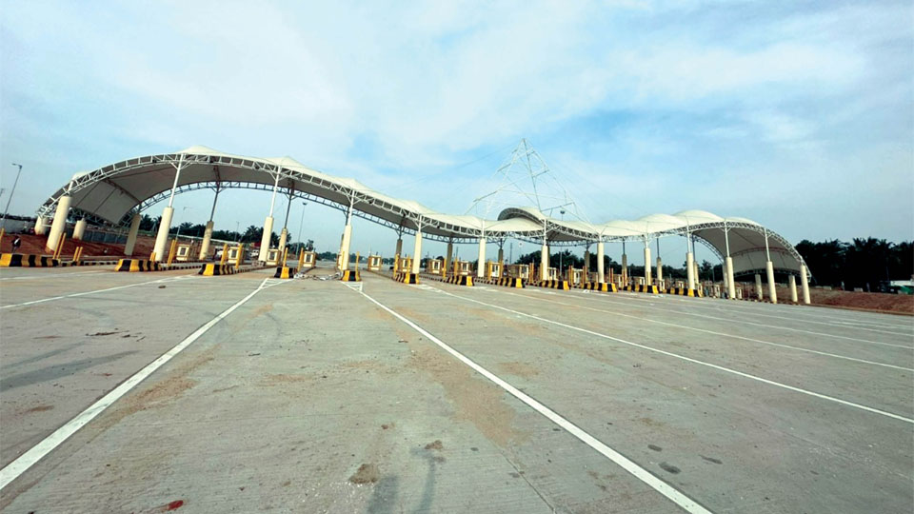
Project Description
Problem Description
User Operations
Existing System
The existing manual toll payment systems are fraught with inefficiencies that impede smooth travel experiences for commuters. Long wait times at toll booths are a common problem, as the manual process of collecting tolls slows down traffic flow and leads to extended queues. This not only causes delays but also results in increased fuel consumption and higher emissions due to idling vehicles, contributing to environmental pollution.
Proposed System
. The system features user registration and authentication, ensuring secure access and data protection. It includes a responsive design for compatibility across devices and utilizes a robust architecture with a MySQL database, PHP for server-side processing, and HTML, CSS, and JavaScript for a user-friendly interface. This centralized platform will streamline toll collection, reduce time spent at toll gates, and offer a secure, modern solution for toll management.
The Online Toll Gate Application streamlines toll payments by offering a user-friendly web interface for vehicle registration, payment processing, and transaction record searching. The application includes:
Proposed Method
Frontend Development: Utilizing Visual Studio for designing responsive and intuitive user interfaces.
Backend Development: Using XAMPP stack (Apache, MySQL, PHP) to handle server-side scripting, database management via phpMyAdmin, and ensuring secure data storage and retrieval.
Apply for Toll
Submit Toll Record
Search Toll Record
Filter by Date or Vehicle type

Slide 7
Description
Problem Description
User Operations
Existing System
The existing manual toll payment systems are fraught with inefficiencies that impede smooth travel experiences for commuters. Long wait times at toll booths are a common problem, as the manual process of collecting tolls slows down traffic flow and leads to extended queues. This not only causes delays but also results in increased fuel consumption and higher emissions due to idling vehicles, contributing to environmental pollution.
Proposed System
. The system features user registration and authentication, ensuring secure access and data protection. It includes a responsive design for compatibility across devices and utilizes a robust architecture with a MySQL database, PHP for server-side processing, and HTML, CSS, and JavaScript for a user-friendly interface. This centralized platform will streamline toll collection, reduce time spent at toll gates, and offer a secure, modern solution for toll management.
The Online Toll Gate Application streamlines toll payments by offering a user-friendly web interface for vehicle registration, payment processing, and transaction record searching. The application includes:
Proposed Method
Frontend Development: Utilizing Visual Studio for designing responsive and intuitive user interfaces.
Backend Development: Using XAMPP stack (Apache, MySQL, PHP) to handle server-side scripting, database management via phpMyAdmin, and ensuring secure data storage and retrieval.
Apply for Toll
Submit Toll Record
Search Toll Record
Filter by Date or Vehicle type

Slide 8
Description
Problem Description
User Operations
The Online Toll Gate Application streamlines toll payments by offering a user-friendly web interface for vehicle registration, payment processing, and transaction record searching. The application includes:
Proposed Method
Frontend Development: Utilizing Visual Studio for designing responsive and intuitive user interfaces.
Backend Development: Using XAMPP stack (Apache, MySQL, PHP) to handle server-side scripting, database management via phpMyAdmin, and ensuring secure data storage and retrieval.
The existing manual toll payment systems are fraught with inefficiencies that impede smooth travel experiences for commuters. Long wait times at toll booths are a common problem, as the manual process of collecting tolls slows down traffic flow and leads to extended queues. This not only causes delays but also results in increased fuel consumption and higher emissions due to idling vehicles, contributing to environmental pollution.
Apply for Toll
Submit Toll Record
Search Toll Record
Filter by Date or Vehicle type

Slide 9
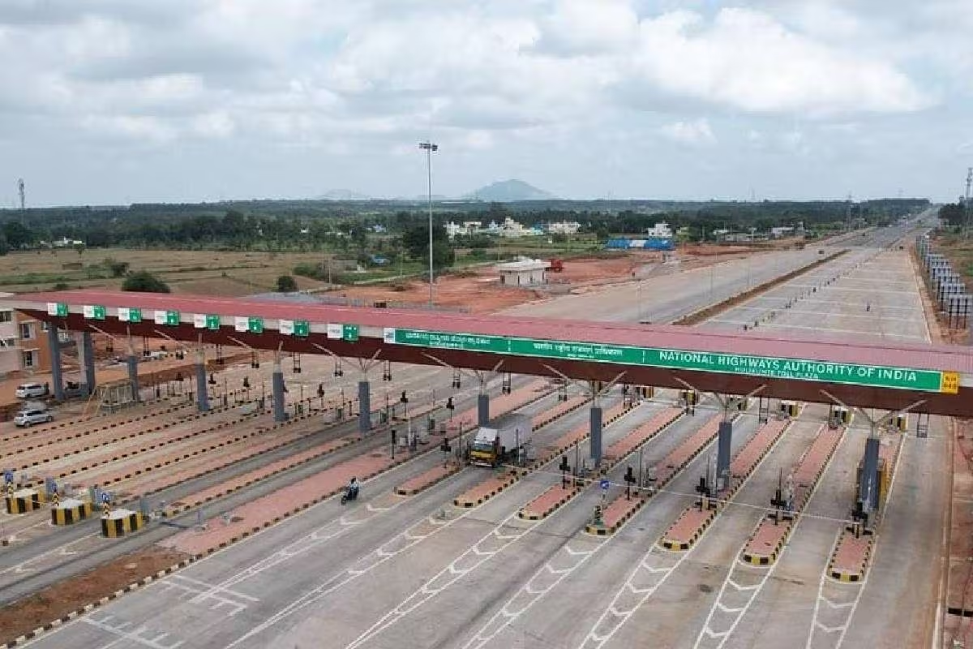
Functionalities:
Function: Home Page
Description: Provides users with an introductory message about the online toll gate application.
Functionalities:
Display a welcome message with brief information about the application.
Include a call-to-action button to apply for toll.
Function: About Us Page
Description: Provides detailed information about the online toll gate application and its mission.
Functionalities:
Display information about the purpose and benefits of the toll gate application.
Include background details and objectives.
Function: Contact Form
Description: Allows users to send inquiries or feedback through a contact form.
Functionalities:
Input fields for name, email, subject, and message.
Validate and submit the contact form to the server.
Function: Search Toll Records
Description: Enables users to search for specific toll records based on criteria such as vehicle type, toll amount, or date.
Functionalities:
Filter and display toll records based on search input.
Dynamically update the search results as the user types or selects criteria.
Description
User Operations
The Online Toll Gate Application streamlines toll payments by offering a user-friendly web interface for vehicle registration, payment processing, and transaction record searching. The application includes:
Proposed Method
Frontend Development: Utilizing Visual Studio for designing responsive and intuitive user interfaces.
Backend Development: Using XAMPP stack (Apache, MySQL, PHP) to handle server-side scripting, database management via phpMyAdmin, and ensuring secure data storage and retrieval.
Apply for Toll
Submit Toll Record
Search Toll Record
Filter by Date or Vehicle type

Slide 10

Functionalities:
Function: Home Page
Description: Provides users with an introductory message about the online toll gate application.
Functionalities:
Display a welcome message with brief information about the application.
Include a call-to-action button to apply for toll.
Function: About Us Page
Description: Provides detailed information about the online toll gate application and its mission.
Functionalities:
Display information about the purpose and benefits of the toll gate application.
Include background details and objectives.
Function: Contact Form
Description: Allows users to send inquiries or feedback through a contact form.
Functionalities:
Input fields for name, email, subject, and message.
Validate and submit the contact form to the server.
Function: Search Toll Records
Description: Enables users to search for specific toll records based on criteria such as vehicle type, toll amount, or date.
Functionalities:
Filter and display toll records based on search input.
Dynamically update the search results as the user types or selects criteria.

Slide 11
Functionalities:
Function: Home Page
Description: Provides users with an introductory message about the online toll gate application.
Functionalities:
Display a welcome message with brief information about the application.
Include a call-to-action button to apply for toll.
Function: About Us Page
Description: Provides detailed information about the online toll gate application and its mission.
Functionalities:
Display information about the purpose and benefits of the toll gate application.
Include background details and objectives.
Function: Contact Form
Description: Allows users to send inquiries or feedback through a contact form.
Functionalities:
Input fields for name, email, subject, and message.
Validate and submit the contact form to the server.
Function: Search Toll Records
Description: Enables users to search for specific toll records based on criteria such as vehicle type, toll amount, or date.
Functionalities:
Filter and display toll records based on search input.
Dynamically update the search results as the user types or selects criteria.

Slide 12
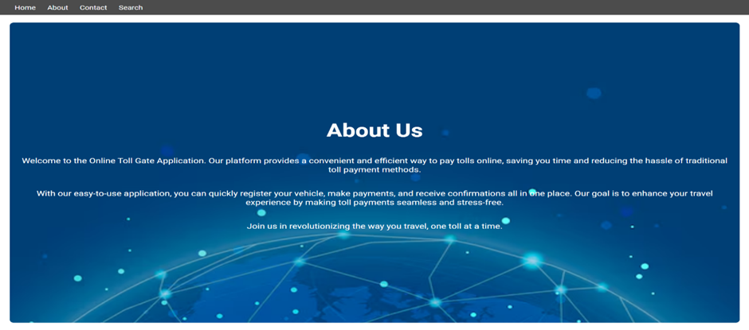
Functionalities:
Function: Home Page
Description: Provides users with an introductory message about the online toll gate application.
Functionalities:
Display a welcome message with brief information about the application.
Include a call-to-action button to apply for toll.
Function: About Us Page
Description: Provides detailed information about the online toll gate application and its mission.
Functionalities:
Display information about the purpose and benefits of the toll gate application.
Include background details and objectives.
Function: Contact Form
Description: Allows users to send inquiries or feedback through a contact form.
Functionalities:
Input fields for name, email, subject, and message.
Validate and submit the contact form to the server.
Function: Search Toll Records
Description: Enables users to search for specific toll records based on criteria such as vehicle type, toll amount, or date.
Functionalities:
Filter and display toll records based on search input.
Dynamically update the search results as the user types or selects criteria.

Slide 13
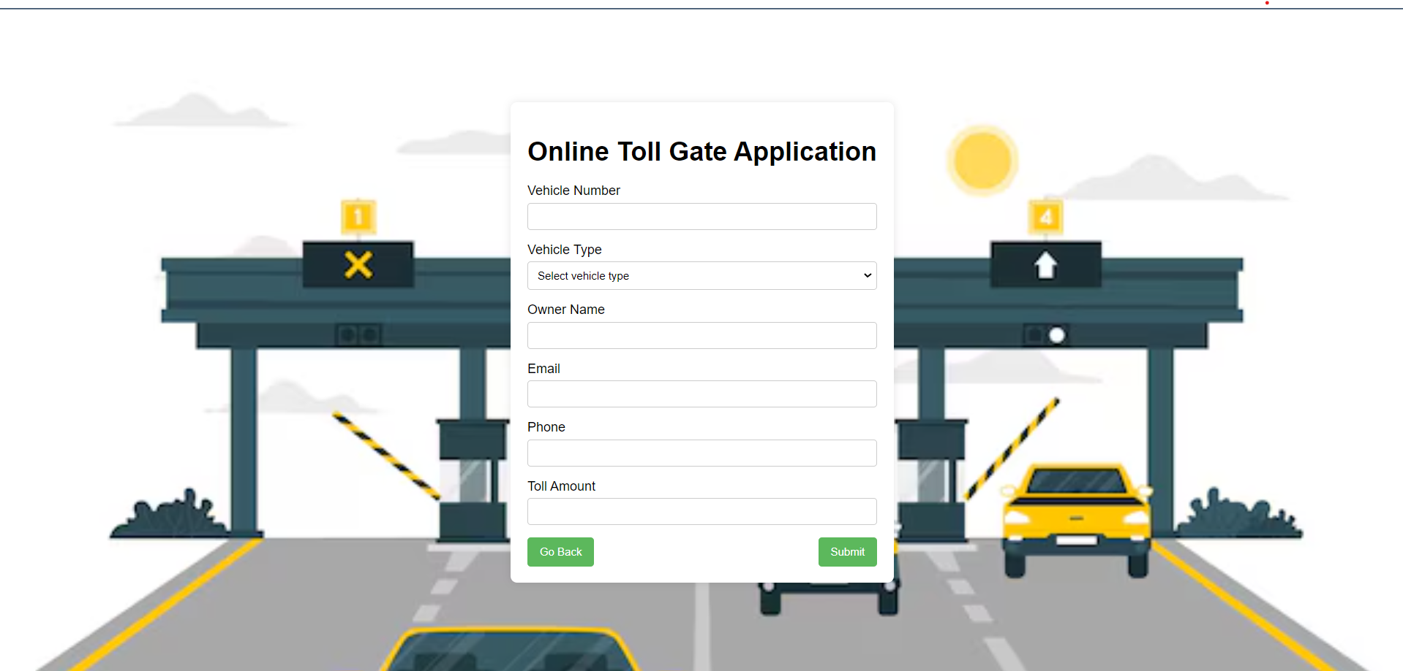
Functionalities:
Function: Home Page
Description: Provides users with an introductory message about the online toll gate application.
Functionalities:
Display a welcome message with brief information about the application.
Include a call-to-action button to apply for toll.
Function: About Us Page
Description: Provides detailed information about the online toll gate application and its mission.
Functionalities:
Display information about the purpose and benefits of the toll gate application.
Include background details and objectives.
Function: Contact Form
Description: Allows users to send inquiries or feedback through a contact form.
Functionalities:
Input fields for name, email, subject, and message.
Validate and submit the contact form to the server.
Function: Search Toll Records
Description: Enables users to search for specific toll records based on criteria such as vehicle type, toll amount, or date.
Functionalities:
Filter and display toll records based on search input.
Dynamically update the search results as the user types or selects criteria.

Slide 14
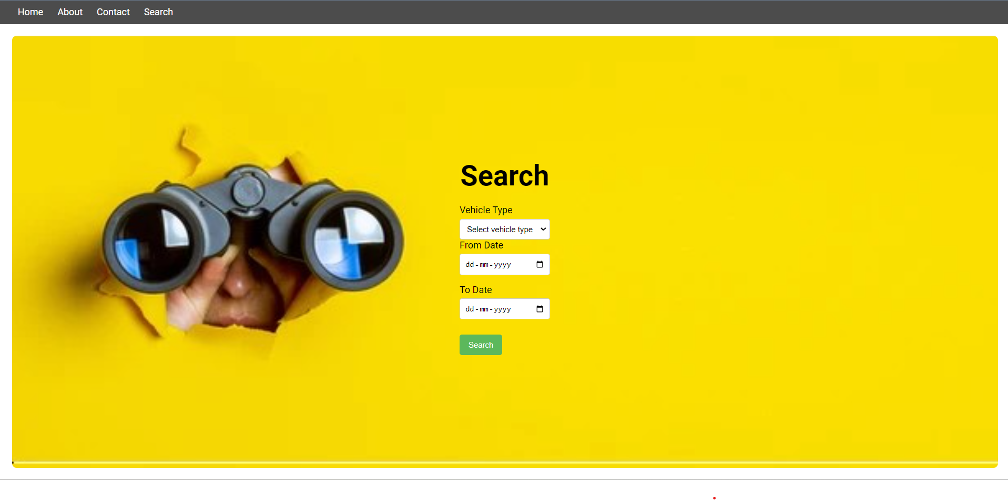
Functionalities:
Function: Home Page
Description: Provides users with an introductory message about the online toll gate application.
Functionalities:
Display a welcome message with brief information about the application.
Include a call-to-action button to apply for toll.
Function: About Us Page
Description: Provides detailed information about the online toll gate application and its mission.
Functionalities:
Display information about the purpose and benefits of the toll gate application.
Include background details and objectives.
Function: Contact Form
Description: Allows users to send inquiries or feedback through a contact form.
Functionalities:
Input fields for name, email, subject, and message.
Validate and submit the contact form to the server.
Function: Search Toll Records
Description: Enables users to search for specific toll records based on criteria such as vehicle type, toll amount, or date.
Functionalities:
Filter and display toll records based on search input.
Dynamically update the search results as the user types or selects criteria.

Slide 15
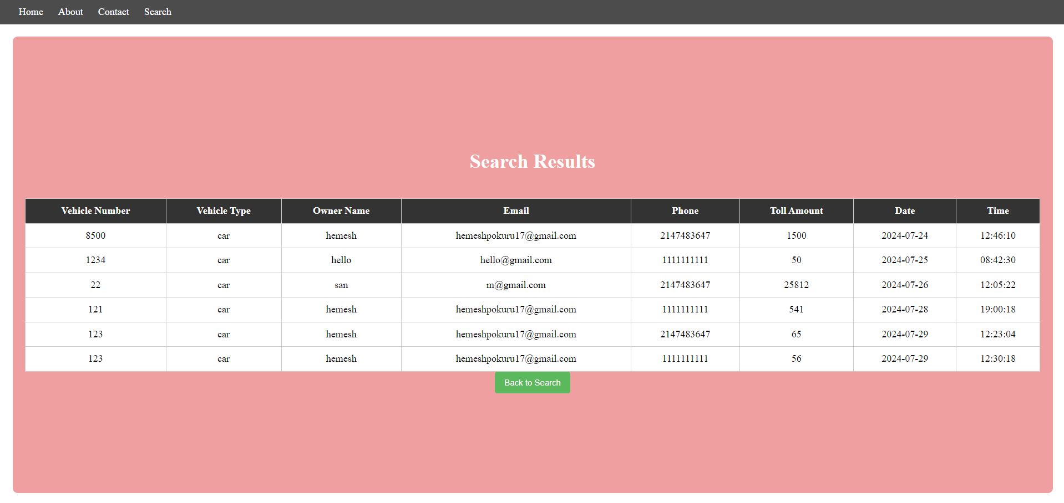


Slide 16
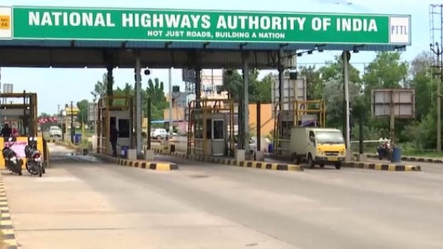

Conclusion:
The "Online Tollgate Application" is a comprehensive web platform designed to streamline toll payment processes for users, allowing them to manage toll payments with ease and efficiency. Developed with a user-friendly interface, the application ensures a seamless experience for registering vehicles, making toll payments, and maintaining detailed records of transactions. By providing features such as vehicle registration, toll payment processing, and search functionalities, the application significantly reduces the time and effort associated with traditional toll payment methods, enhancing overall user convenience and satisfaction.
Future Scope:
One of the major improvement is the integration of advanced search and filtering options. This includes allowing users to search for toll records based on specific criteria such as vehicle type, toll amount, and date range, making it easier to find relevant information quickly. Additionally, implementing real-time toll rate updates and notifications can keep users informed about any changes or promotions, enhancing the application's utility.
Another significant enhancement is the incorporation of features to boost user interaction and community engagement. Enabling users to receive digital receipts, participate in loyalty programs, and access toll history reports can add value to the user experience. Integrating the application with navigation and route planning tools can help users optimize their travel routes and toll expenses.

Slide 17
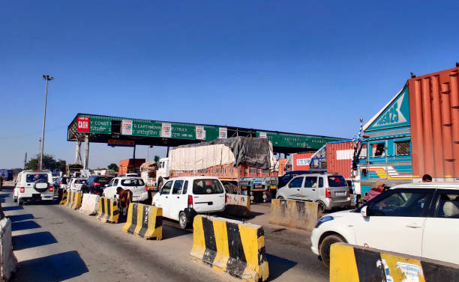
References:
Conclusion:
[1] Edward B. Panganiban, Jennifer C. Dela Cruz, “RFID-Based Vehicle Monitoring System”, School of EECE, Mapua University, IEEE 2017.
[2] M. Sarbini, S. Hassan, T. Jiann, PM. Ahmad, “Design of an RFID-based speed monitoring system for road vehicles in Brunei Darussalam”, IEEE 2014, pp. 219-223.
[3] C.R. Kumar, B. Vijayalakshmi, C. Ramesh, C. Pandian, “Vehicle Theft Alarm and Tracking The Location Using RFID & GPS”, International Journal of Emerging Technology and Advanced Engineering Website: www.ijetae.com ISO Certified Journal 2013, pp. 525528.
[4] Sanchit Agarwal, Shachi Gupta, Nidheesh Sharma, “Electronic Toll Collection System Using Barcode Laser Technology”, International Journal of Emerging Trends & Technology in Computer Science (IJETTCS), Vol 3, 2014
[5] D. Kiranmayi, “Vehicle Monitoring System Using RFID”, Durugu Kiranmayi / (IJCSIT) International Journal of Computer Science and Information Technologies, Vol. 6 (3), 2016, pp. 1444-1447
[6] R. Karthikayeni1, P. KeerthikaBala2, K. Vignesh, “toll plaza payment using QR code”, International Research Journal of Engineering and Technology, 2018.
[7] Aishwarya Agarwal, “Automatic License Plate Recognition using Raspberry Pi,” IEEE International Interdisciplinary Conference on Science Technology Engineering Management Singapore, 22nd, 23rd April 2017.
[8] Persad, Khali, C. Michael Walton, and Shahriyar Hussain. Toll Collection Technology and Best Practices. No. Product 0-5217-P1. 2007.
[9] Li, Shuguang, et al. "Video-based traffic data collection system for multiple vehicle types."
The "Online Tollgate Application" is a comprehensive web platform designed to streamline toll payment processes for users, allowing them to manage toll payments with ease and efficiency. Developed with a user-friendly interface, the application ensures a seamless experience for registering vehicles, making toll payments, and maintaining detailed records of transactions. By providing features such as vehicle registration, toll payment processing, and search functionalities, the application significantly reduces the time and effort associated with traditional toll payment methods, enhancing overall user convenience and satisfaction.
Future Enhancement:
One of the major improvement is the integration of advanced search and filtering options. This includes allowing users to search for toll records based on specific criteria such as vehicle type, toll amount, and date range, making it easier to find relevant information quickly. Additionally, implementing real-time toll rate updates and notifications can keep users informed about any changes or promotions, enhancing the application's utility.
Another significant enhancement is the incorporation of features to boost user interaction and community engagement. Enabling users to receive digital receipts, participate in loyalty programs, and access toll history reports can add value to the user experience. Integrating the application with navigation and route planning tools can help users optimize their travel routes and toll expenses.

Slide 18
References:
[1] Edward B. Panganiban, Jennifer C. Dela Cruz, “RFID-Based Vehicle Monitoring System”, School of EECE, Mapua University, IEEE 2017.
[2] M. Sarbini, S. Hassan, T. Jiann, PM. Ahmad, “Design of an RFID-based speed monitoring system for road vehicles in Brunei Darussalam”, IEEE 2014, pp. 219-223.
[3] C.R. Kumar, B. Vijayalakshmi, C. Ramesh, C. Pandian, “Vehicle Theft Alarm and Tracking The Location Using RFID & GPS”, International Journal of Emerging Technology and Advanced Engineering Website: www.ijetae.com ISO Certified Journal 2013, pp. 525528.
[4] Sanchit Agarwal, Shachi Gupta, Nidheesh Sharma, “Electronic Toll Collection System Using Barcode Laser Technology”, International Journal of Emerging Trends & Technology in Computer Science (IJETTCS), Vol 3, 2014
[5] D. Kiranmayi, “Vehicle Monitoring System Using RFID”, Durugu Kiranmayi / (IJCSIT) International Journal of Computer Science and Information Technologies, Vol. 6 (3), 2016, pp. 1444-1447
[6] R. Karthikayeni1, P. KeerthikaBala2, K. Vignesh, “toll plaza payment using QR code”, International Research Journal of Engineering and Technology, 2018.
[7] Aishwarya Agarwal, “Automatic License Plate Recognition using Raspberry Pi,” IEEE International Interdisciplinary Conference on Science Technology Engineering Management Singapore, 22nd, 23rd April 2017.
[8] Persad, Khali, C. Michael Walton, and Shahriyar Hussain. Toll Collection Technology and Best Practices. No. Product 0-5217-P1. 2007.
[9] Li, Shuguang, et al. "Video-based traffic data collection system for multiple vehicle types."

Slide 19


